Slide 1
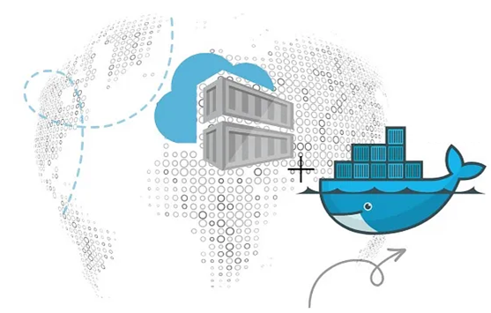
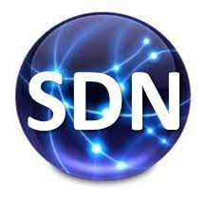
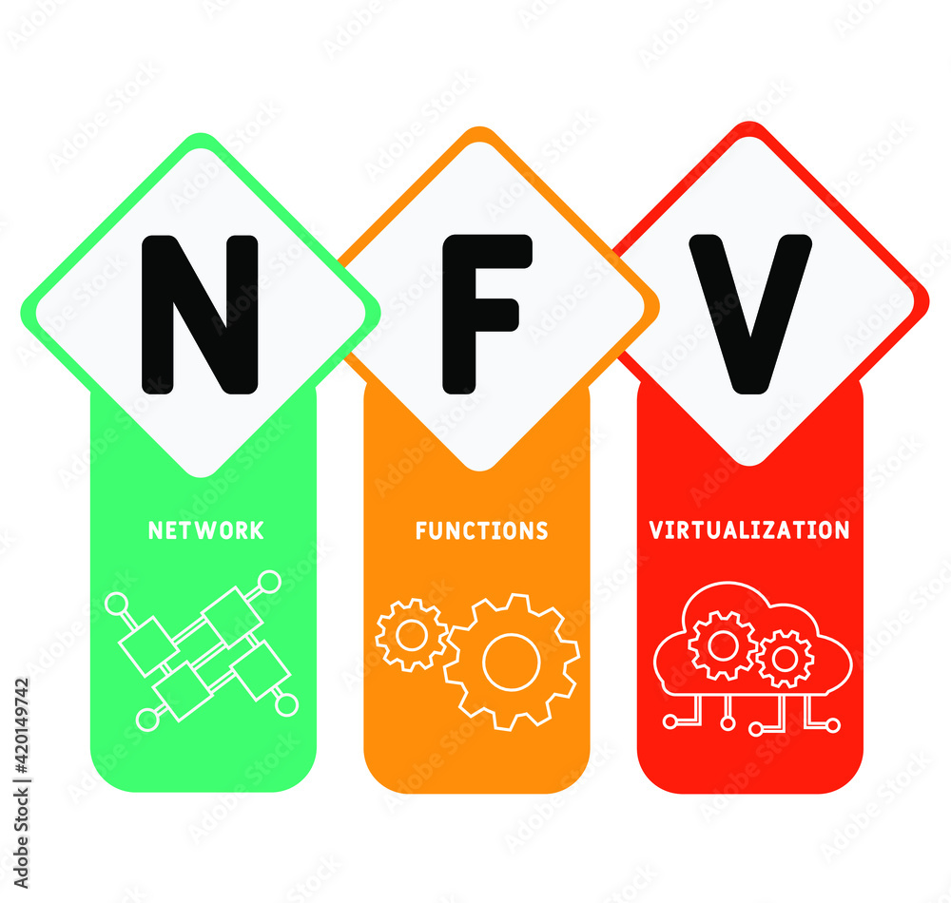
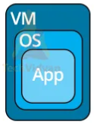
PDS
Computer Vision
Gyroscope Sensor Accelerometer
https://github.com/amelcharolinesgn2/Gyroscope-Sensor-Data-Accelerometer
https://github.com/siagianp
https://www.youtube.com/@AmelOline/videos
https://github.com/amelcharolinesgn2/IoT_simulator-mqtt-NodeRed
https://github.com/amelcharolinesgn2/Cloud-Infrastructures
https://github.com/amelcharolinesgn2/ClouD-Infrastructure-SISKA-2025
Notes:
https://medium.com/buildpiper/simplifying-containerization-with-docker-run-command-2f74e114f42a
https://github.com/IBA-Group-IT/IoT-data-simulator
https://www.bevywise.com/blog/docker-mqtt-broker-easy-service-manageability/

Slide 2
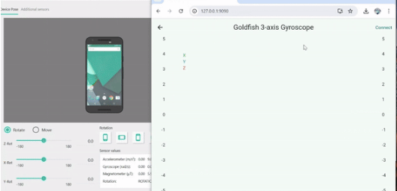
Ex4: >>
Sensors Data Streaming
Gyroscope Sensor Accelerometer
Sensor Accelarate

Slide 3
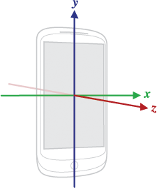
Sensors Data Streaming
Ex4: >>
Feature
Gyroscope Sensor Accelerometer
Features:>>
1. Real-Time Sensor Data Collection
Data is collected from smartphone sensors (Accelerometer, Gyroscope, Magnetic field, Gravity) using the SensorServer app.
Sensor data is transmitted via WebSocket from the phone to a Kafka producer.
2. Data Streaming and Processing
Kafka acts as the message broker, streaming data to designated topics for InfluxDB and MongoDB.
The system supports two databases:
InfluxDB: Specialized for time-series data storage and includes native visualization capabilities.
MongoDB: Stores unstructured sensor data flexibly.
3. Consumer APIs
Flask-based APIs consume data from Kafka and store it in respective databases:
InfluxDB Consumer API:
Handles data sent to InfluxDB.
MongoDB Consumer API:
Handles data sent to MongoDB.
Flask-SocketIO is used to send log messages to the frontend, such as:
Starting/Stopping the pipeline.
Logs of data written to the database.
4. Interactive Frontend
Both APIs provide a browser-based interface for pipeline management:
Start/stop data pipelines.
Configure database credentials and settings.
5. Visualization
InfluxDB's built-in visualization tools offer quick insights into time-series data.
Grafana supports advanced dashboards, integrating both MongoDB and InfluxDB for custom visualization.
6. Portability and Scalability
The system is containerized, with all services defined in a docker-compose.yml file.
APIs are pushed to Docker Hub, allowing deployment across various environments.
Overview
A real-time streaming, storage, and visualization system for sensor data. It leverages Kafka for data streaming, InfluxDB (time-series database) and MongoDB (NoSQL database) for storage, and Grafana for visualization. Sensor data is captured using the SensorServer app and streamed to Kafka. Consumer APIs for each database handle data ingestion and storage, with the system being fully containerized and orchestrated using Docker Compose.
Notes:
https://github.com/TouradBaba/sensors_data_streaming
https://github.com/UmerCodez/SensorSpot
https://github.com/UmerCodez/SensorServer
https://github.com/facundofarias/awesome-websockets
https://github.com/UmerCodez/SensorServer

Slide 4
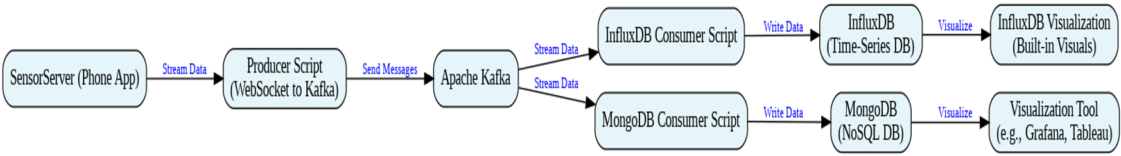
Ex4: >>
Sensors Data Streaming
Gyroscope Sensor Accelerometer
Block System

Slide 5
Ex4: >>
Sensors Data Streaming
Gyroscope Sensor Accelerometer
Repository Structure
Repository Structure
APIs_Requests/
influxdb_consumer_api.py # Scripts to interact with the InfluxDB consumer API via `requests` library
mongodb_consumer_api.py # Scripts to interact with the MongoDB consumer API via `requests` library
Query_DBs/
query_influxdb.py # Script for querying InfluxDB
query_mongodb.py # Script for querying MongoDB
assets/
GIF.gif # Real-Time Visualization of sensor data
UML_Diagram.png # System architecture diagram
Grafana_Visualization.png # Grafana dashboard visualization
InfluxDB_Visualization.png # InfluxDB dashboard visualization
screenshot_influxdb_consumer_app.png # Screenshot of the InfluxDB Consumer App
screenshot_mongodb_consumer_app.png # Screenshot of the MongoDB Consumer App
influxdb_consumer_api/
templates/ # HTML templates for InfluxDB Consumer API interface
Dockerfile # Dockerfile for the API
app.py # Flask API for InfluxDB Consumer
producer.py # Kafka producer for InfluxDB
requirements.txt # Dependencies for InfluxDB Consumer API
mongodb_consumer_api/
templates/ # HTML templates for MongoDB Consumer API interface
Dockerfile # Dockerfile for the API
app.py # Flask API for MongoDB Consumer
producer.py # Kafka producer for MongoDB
requirements.txt # Dependencies for MongoDB Consumer API
RealTime_visual_sensors_data.py # Script for visualizing sensor data in real time
docker-compose.yml # Docker Compose file for orchestration
requirements.txt # Project dependencies

Slide 6
Ex4: >>
Sensors Data Streaming
Gyroscope Sensor Accelerometer
Setup and Configuration
Prerequisites
SensorServer App:
Install and configure the link: SensorServer app on your smartphone(Android Only) to stream sensor data via WebSocket.
Docker:
Ensure that Docker is installed and running on your system. Install Docker from link https://www.docker.com/products/docker-desktop/
Python:
This project uses Python version 3.12.6. Install Python from link
https://github.com/amelcharolinesgn2/IoT_Project/blob/main/SensorServer.zip
https://www.python.org/downloads/

Slide 7
Ex4: >>
Sensors Data Streaming
Gyroscope Sensor Accelerometer
Configuration Steps
Work Flow
Clone the Repository
Clone the repository to your local machine:
git clone https://github.com/amelcharolinesgn2/IoT_Project/blob/main/sensors_data_streaming.zip.git cd sensors_data_streaming
2. Create a Virtual Environment
It's recommended to create a virtual environment to manage the Python dependencies for the project:
python -m venv myenv
Activate the virtual environment:
On Windows: myvenv\Scripts\activate
On macOS/Linux: source myenv/bin/activate
3. Install Python Dependencies
Install the required Python dependencies:
pip install -r requirements.txt
4. Start Docker
Make sure Docker is installed and running on your system.
5. Starting the System
Run the following command to launch the system:
docker-compose up --build
6. InfluxDB
> Access the InfluxDB dashboard at http://localhost:8086 after starting Docker Compose.
> Default credentials:
Username: admin
Password: admin12345Create an API Token:
Navigate to InfluxDB CLI → Initialize Client → Copy the Token.
Use this token in the InfluxDB Consumer API configuration.
7. MongoDB
MongoDB uses the default database (sensor_data) and collection (sensor_data).
No additional configuration is required.
8. APIs
APIs are accessible via localhost as configured in the docker-compose.yml file.
InfluxDB Consumer API:
Access the InfluxDB Consumer App at http://localhost:5000.
MongoDB Consumer API:
Access the MongoDB Consumer App at http://localhost:5001.
You can also interact with the APIs using scripts located in the APIs_Requests/ directory.
9. Grafana
Access Grafana at http://localhost:3000.
Add data sources:
InfluxDB: Configure it with the credentials and token created earlier.
MongoDB: Use the MongoDB Data Source Plugin.
Create dashboards with custom visualizations.
Starting the Pipeline: When a pipeline is started in a given consumer API (InfluxDB or MongoDB), the API first calls the Kafka Producer.
Data Collection: The Kafka Producer retrieves real-time sensor data from the SensorServer app, which streams data via WebSocket.
Data Streaming: The data from the phone's sensors is sent to the corresponding Kafka topic (sensor-data-influxdb for InfluxDB or sensor-data-mongodb for MongoDB).
Data Storage: The API then consumes data from the Kafka topic. The data is processed and then stored in the respective database (InfluxDB or MongoDB).
Querying the Databases and Real-Time Visualization
The Query_DBs and APIs_Requests folders contain scripts that enable interaction with the databases and consumer APIs:
Query_DBs: The scripts query_influxdb.py and query_mongodb.py allow you to query the data stored in InfluxDB and MongoDB, respectively.
APIs_Requests: The scripts influxdb_consumer_api.py and mongodb_consumer_api.py enable you to interact with the Flask-based APIs to start/stop the pipeline.
The RealTime_visual_sensors_data.py is for visualizing sensor data in real time. It allows you to directly monitor the sensor data streamed from the SensorServer.

Slide 8
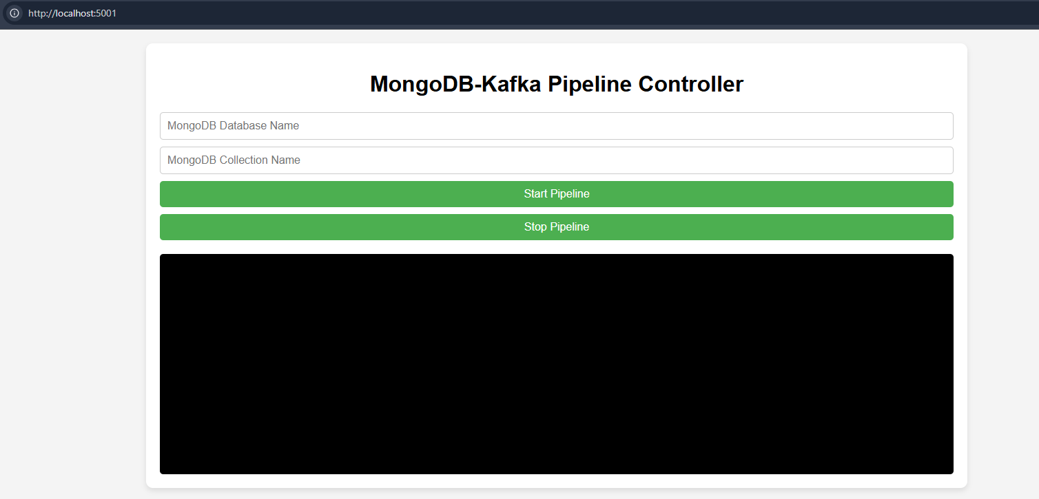
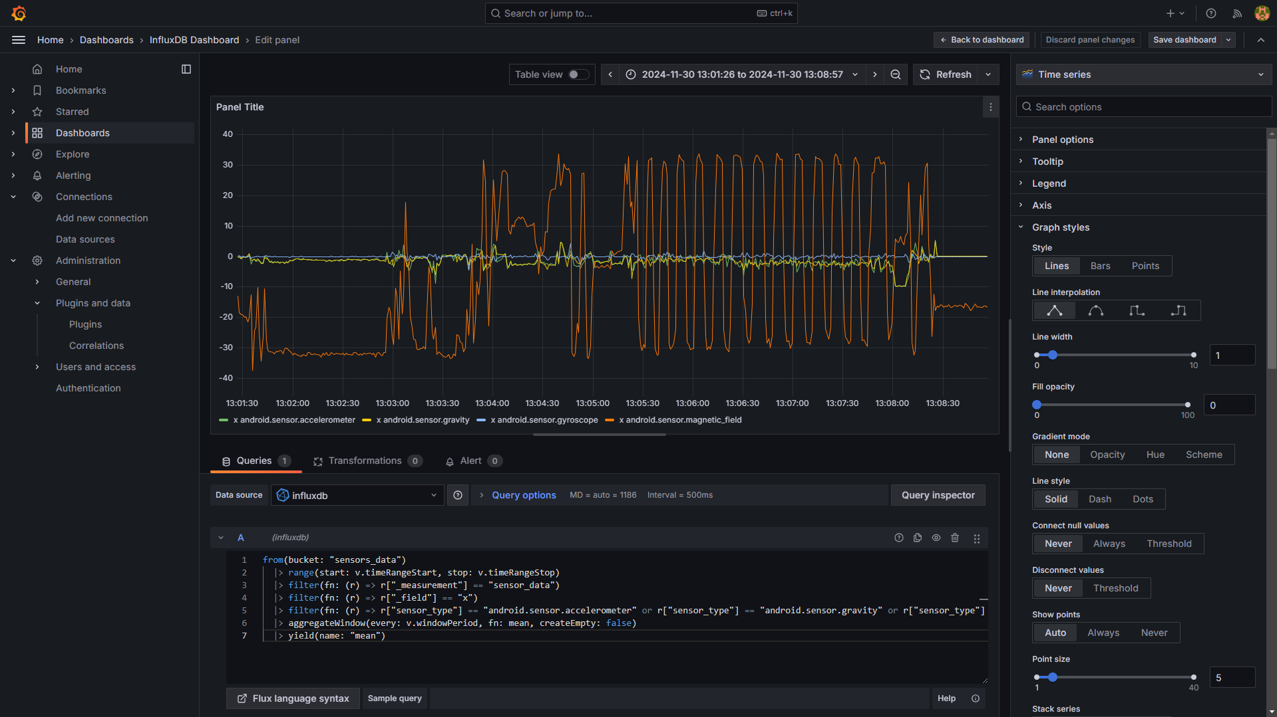
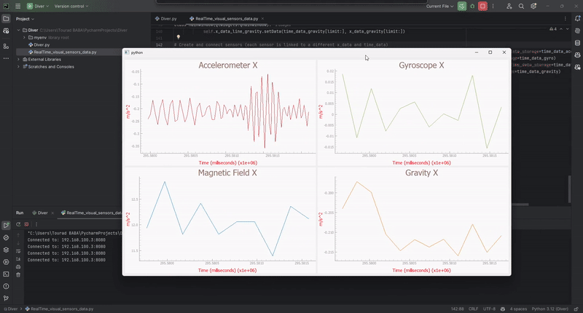
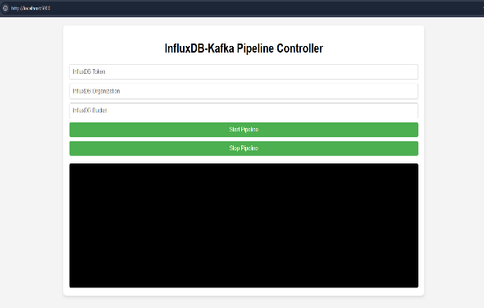
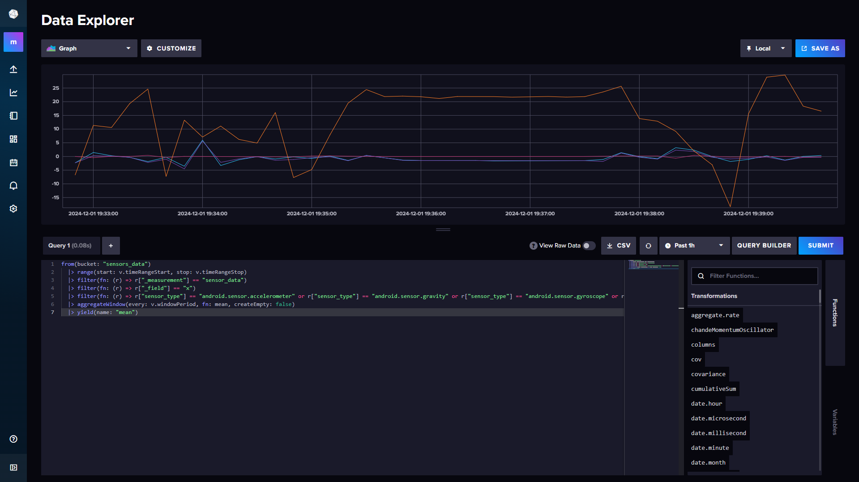
Ex4: >>
Sensors Data Streaming
Gyroscope Sensor Accelerometer
Demo
InfluxDB Consumer API Interface
MongoDB Consumer API Interface
Grafana Visualization
Real-Time Visualization of Sensor Data
InfluxDB Visualization

Slide 9
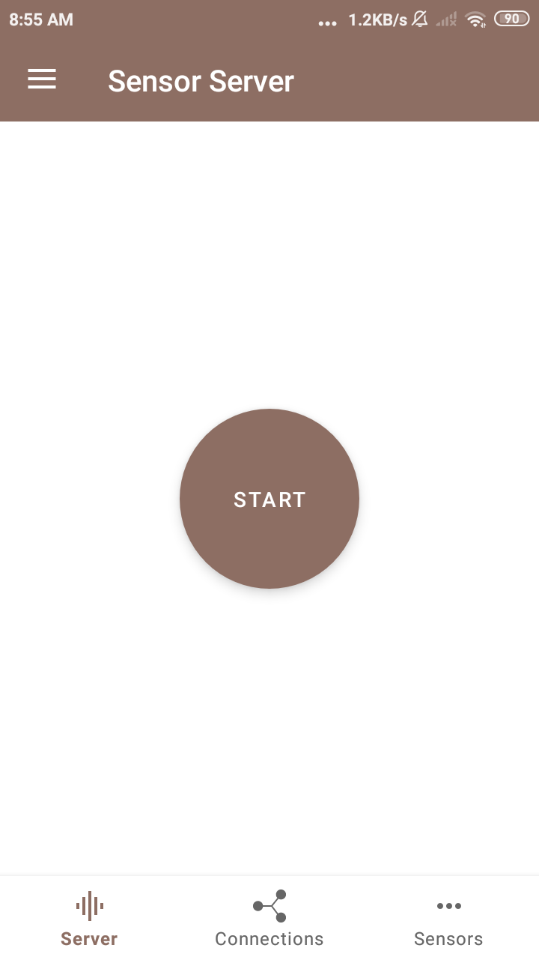
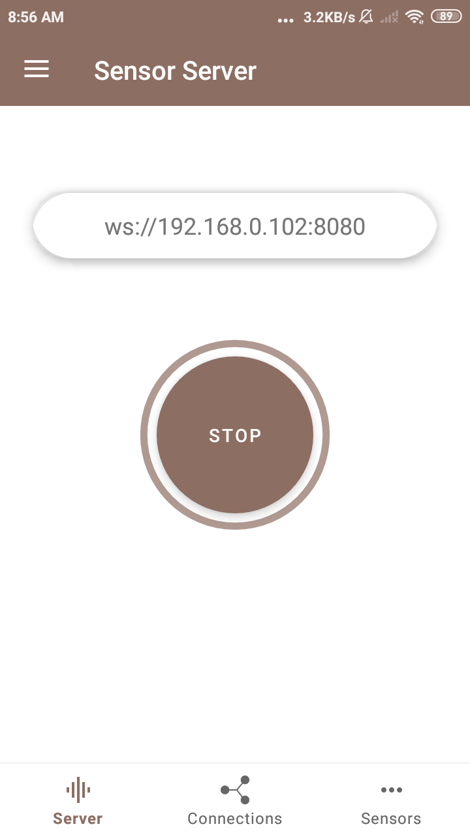
Ex4: >>
SensorsServer
Gyroscope Sensor Accelerometer
https://github.com/amelcharolinesgn2/IoT_Project/blob/main/SensorServer.zip
Sensor Server
SensorServer transforms Android device into a versatile sensor hub, providing real-time access to its entire array of sensors. It allows multiple Websocket clients to simultaneously connect and retrieve live sensor data.The app exposes all available sensors of the Android device, enabling WebSocket clients to read sensor data related to device position, motion (e.g., accelerometer, gyroscope), environment (e.g., temperature, light, pressure), GPS location, and even touchscreen interactions.
Notes:
https://github.com/amelcharolinesgn2/IoT_Project/blob/main/SensorServer.zip

Slide 10
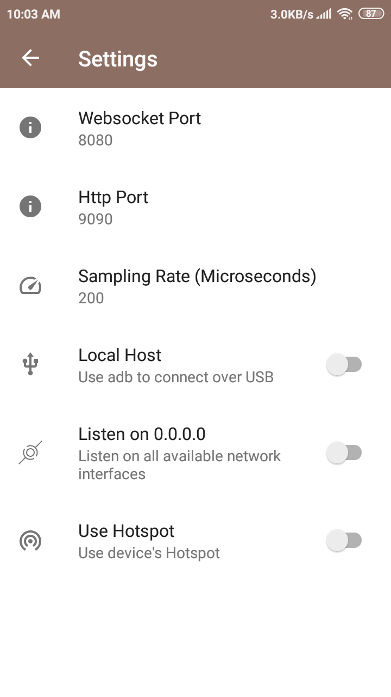
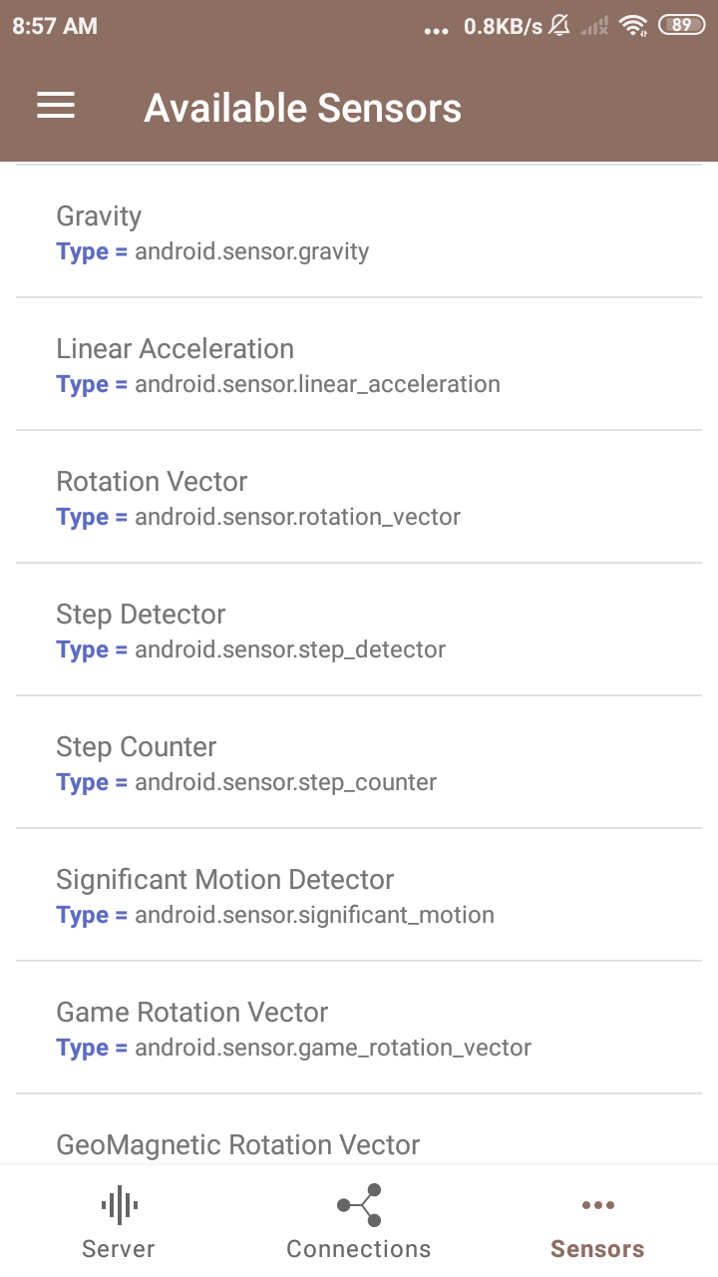
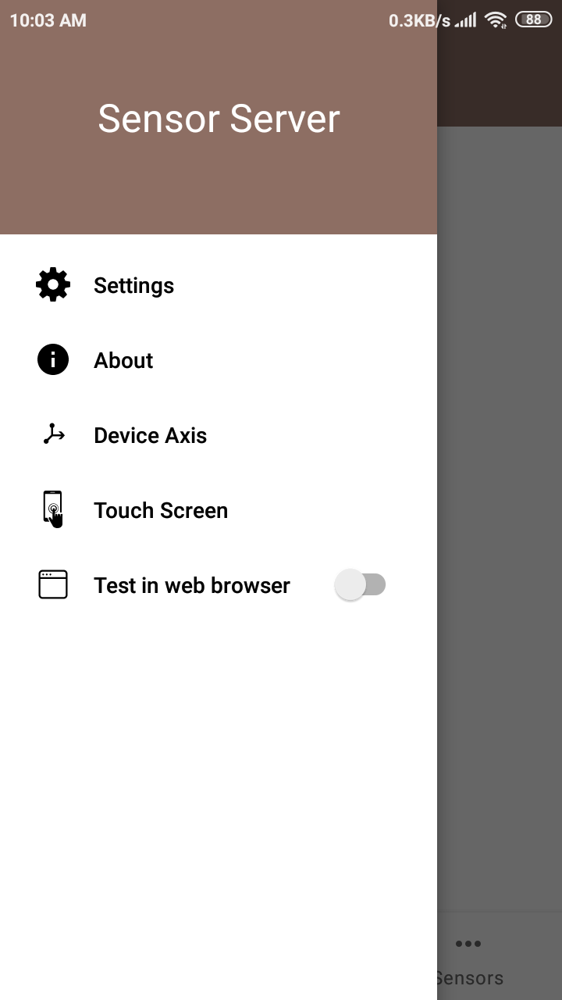
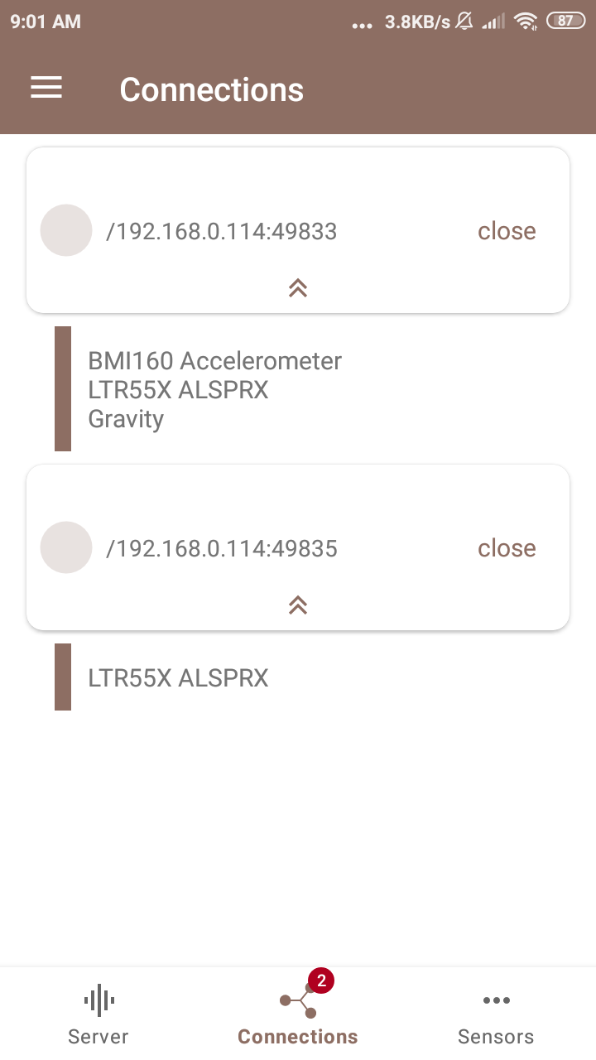
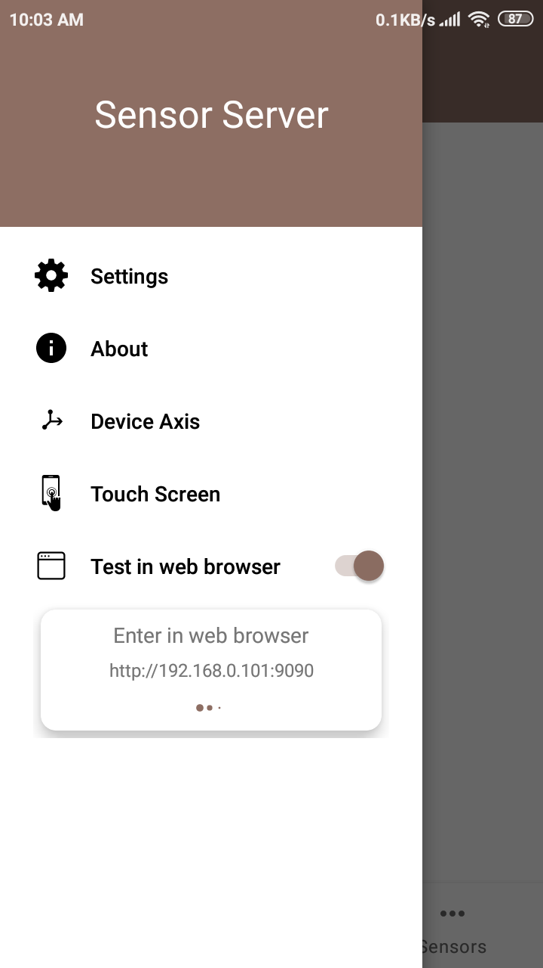
Gyroscope Sensor Accelerometer
Sensor Server
This application functions as a Websocket Server, you will require a Websocket Client API to establish a connection with the application. To obtain a Websocket library for your preferred programming language click
https://github.com/amelcharolinesgn2/Gyroscope-Sensor-Data-Accelerometer/blob/main/awesome-websockets-master.zip

Slide 11
Gyroscope Sensor Accelerometer
Websocket
Websocket Client API to establish a connection with the application.
https://github.com/amelcharolinesgn2/Gyroscope-Sensor-Data-Accelerometer/blob/main/awesome-websockets-master.zip
https://github.com/facundofarias/awesome-websockets
https://en.wikipedia.org/wiki/WebSocket
Haskell
Websockets - A Haskell library for creating WebSocket-capable servers.
n2o - Haskell implementation of Erlang's n2o - web server on websockets.
Java VM
Clojure
Sente - Realtime web comms for Clojure/Script.
Chord - Library designed to bridge the gap between the triad of CLJ/CLJS, web-sockets and core.async.
Luminusweb - Luminus is a Clojure micro-framework based on a set of lightweight libraries.
Java
Project Tyrus - JSR 356: Java API for WebSocket - Reference Implementation.
Java-WebSocket - Barebones WebSocket client and server implementation written in 100% Java.
Atmosphere - Realtime Client Server Framework for the JVM, supporting WebSockets with Cross-Browser Fallbacks.
Webbit - Java event based WebSocket and HTTP server.
nv-websocket-client - High-quality WebSocket client implementation in Java which.
Kotlin
Scarlet - Tinder's Retrofit inspired WebSocket client for Kotlin, Java, and Android
Scala
Play - The high velocity web framework for Java and Scala.
Finagle-websocket - Finagle Websocket clients and servers.

Slide 12
Ex4: >>
Sensor Server
Gyroscope Sensor Accelerometer
https://github.com/amelcharolinesgn2/IoT_Project/blob/main/SensorServer.zip
Once connected, client will receive sensor data in JSON Array (float type values) through websocket.onMessage.
A snapshot from accelerometer.
{
"accuracy": 2,
"timestamp": 3925657519043709,
"values": [0.31892395,-0.97802734,10.049896]
}
Usage
To receive sensor data, Websocket client must connect to the app using following URL.
ws://<ip>:<port>/sensor/connect?type=<sensor type here>
Value for the type parameter can be found by navigating to Available Sensors in the app.
For example:
For accelerometer /sensor/connect?type=android.sensor.accelerometer .
For gyroscope /sensor/connect?type=android.sensor.gyroscope .
For step detector /sensor/connect?type=android.sensor.step_detector
so on...
Notes:
https://github.com/amelcharolinesgn2/IoT_Project/blob/main/SensorServer.zip

Slide 13
Ex4: >>
Undocumented (mostly QTI) sensors on Android devices
Some Android devices have additional sensors like Coarse Motion Classifier (com.qti.sensor.motion_classifier), Basic Gesture (com.qti.sensor.basic_gestures) etc which are not documented on offical android docs. Please refer to this Blog for corresponding values in values array
Supports multiple connections to multiple sensors simultaneously
Multiple WebSocket clients can connect to a specific type of sensor. For example, by connecting to /sensor/connect?type=android.sensor.accelerometer multiple times, separate connections to the accelerometer sensor are created. Each connected client will receive accelerometer data simultaneously.
Additionally, it is possible to connect to different types of sensors from either the same or different machines. For instance, one WebSocket client object can connect to the accelerometer, while another WebSocket client object can connect to the gyroscope. To view all active connections, you can select the "Connections" navigation button.
where
Array Item Description
values[0] Acceleration force along the x axis (including gravity)
values[1] Acceleration force along the y axis (including gravity)
values[2] Acceleration force along the z axis (including gravity)
And timestamp is the time in nanoseconds at which the event happened
Use JSON parser to get these individual values.
Note : Use following links to know what each value in values array corresponds to
For motion sensors /topics/sensors/sensors_motion
For position sensors /topics/sensors/sensors_position
For Environmental sensors /topics/sensors/sensors_environment

Slide 14
Ex4: >>
Example: Websocket client (Python)
Here is a simple websocket client in python link: using websocket-client api which receives live data from accelerometer sensor.
Your device's IP might be different when you tap start button, so make sure you are using correct IP address at client side
Also see Connecting to Multiple Sensors Using Threading in Python
https://github.com/websocket-client/websocket-client
https://github.com/websocket-client/websocket-client
import websocket
import json
def on_message(ws, message):
values = json.loads(message)['values']
x = values[0]
y = values[1]
z = values[2]
print("x = ", x , "y = ", y , "z = ", z )
def on_error(ws, error):
print("error occurred ", error)
def on_close(ws, close_code, reason):
print("connection closed : ", reason)
def on_open(ws):
print("connected")
def connect(url):
ws = websocket.WebSocketApp(url,
on_open=on_open,
on_message=on_message,
on_error=on_error,
on_close=on_close)
ws.run_forever()
connect("ws://192.168.0.103:8080/sensor/connect?type=android.sensor.accelerometer")
Connecting To The Server without hardcoding IP Address and Port No
In networks using DHCP (Dynamic Host Configuration Protocol), devices frequently receive different IP addresses upon reconnection, making it impractical to rely on hardcoded network configurations. To address this challenge, the app supports Zero-configuration networking (Zeroconf/mDNS), enabling automatic server discovery on local networks. This feature eliminates the need for clients to hardcode IP addresses and port numbers when connecting to the WebSocket server. When enabled by the app user, the server broadcasts its presence on the network using the service type _websocket._tcp, allowing clients to discover the server automatically. Clients can now implement service discovery to locate the server dynamically, rather than relying on hardcoded network configurations.
See complete python Example at Connecting To the Server Using Service Discovery
Using Multiple Sensors Over single Websocket Connection
You can also connect to multiple sensors over single websocket connection. To use multiple sensors over single websocket connection use following URL.
ws://<ip>:<port>/sensors/connect?types=["<type1>","<type2>","<type3>"...]
By connecting using above URL you will receive JSON response containing sensor data along with a type of sensor. See complete example at Using Multiple Sensors On Single Websocket Connection. Avoid connecting too many sensors over single connection, link : https://github.com/amelcharolinesgn2/Gyroscope-Sensor-Data-Accelerometer/blob/main/Connecting%20to%20Multiple%20Sensors%20Using%20Threading%20in%20Python

Slide 15
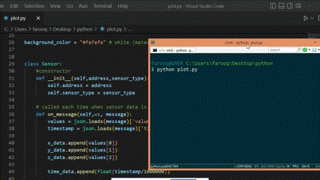
Ex4: >>
Reading Touch Screen Data
By connecting to the address ws://<ip>:<port>/touchscreen, clients can receive touch screen events in following JSON formate.
"ACTION_DOWN" indicates that a user has touched the screen. "ACTION_UP" means the user has removed their finger from the screen. "ACTION_MOVE" implies the user is sliding their finger across the screen. See Controlling Mouse Movement Using SensorServer app : https://github.com/amelcharolinesgn2/Gyroscope-Sensor-Data-Accelerometer/blob/main/Controlling%20Mouse%20Using%20SensorServer%20App
Getting Device Location Using GPS
You can access device location through GPS using following URL.
ws://<ip>:<port>/gps
See Getting Data From GPS for more details
Real Time plotting
Real time plot of Accelerometer using PyQtGraph
https://github.com/amelcharolinesgn2/Gyroscope-Sensor-Data-Accelerometer/blob/main/Real%20time%20plot%20of%20Accelerometer%20using%20PyQtGraph
Key | Value
x | x coordinate of touch
y | y coordinate of touch
action | ACTION_MOVE or ACTION_UP or ACTION_DOWN
https://github.com/amelcharolinesgn2/Gyroscope-Sensor-Data-Accelerometer/blob/main/Getting%20Data%20From%20GPS
https://www.pyqtgraph.org/
"""
Python code to show real time plot from live accelerometer's
data recieved via SensorServer app over websocket
"""
from PyQt5 import QtWidgets, QtCore
import pyqtgraph as pg
import sys # We need sys so that we can pass argv to QApplication
import websocket
import json
import threading
#shared data
x_data = []
y_data = []
z_data = []
time_data = []

Slide 16
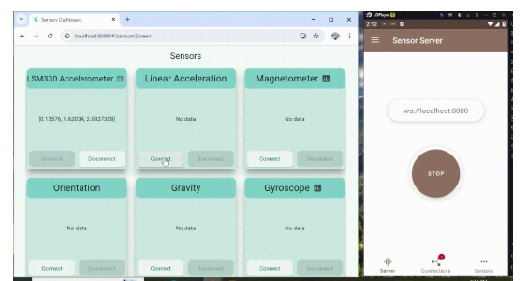
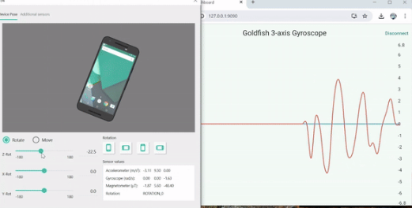
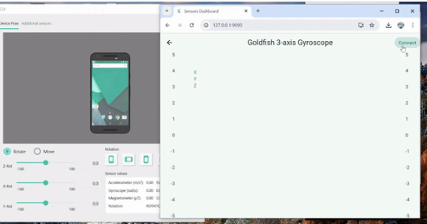
Ex4: >>
Testing in a Web Browser
You can also view your phone's sensor data in a Web Browser. Open the app's navigation drawer menu and enable Test in a Web Browser.Once the web server is running, the app will display an address on your screen. This address will look something like http://<ip>:<port>.On your device or another computer on the same network, open a web browser and enter that address. The web browser will now display a list of all the sensors available on your device. The web interface have options to connect to and disconnect from individual sensors, allowing you to view their real-time data readings.

Slide 17
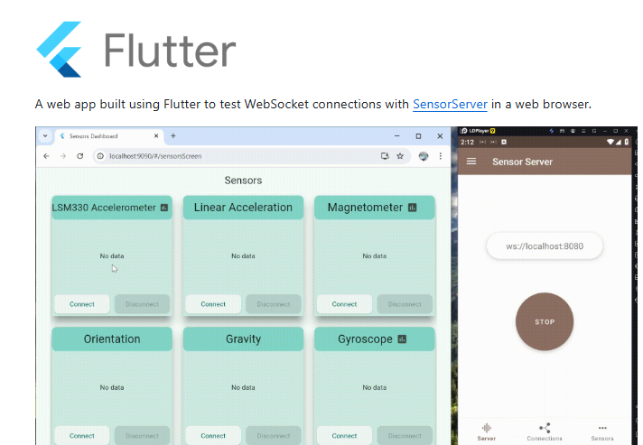
Ex4: >>
This web app is built using Flutter and its source could be found under sensors_dashboard.
However, there's one current limitation to be aware of. The app is built with Flutter using the --web-renderer canvaskit option. This means that the resulting app will have some dependencies that need to be downloaded from the internet. This means that any device accessing the web app through a browser will require an internet connection to function properly.
The web app is built and deployed to Android's assets folder via python deploy_web_app.py
Connecting over Hotspot 🔥
If you don't have Wifi network at your work place you can directly connect websocket clients to the app by enabling Hotspot Option from settings. Just make sure that websocket clients are connected to your phone's hotspot
Connecting over USB (using ADB)
To connect over USB make sure USB debugging option is enable in your phone and ADB (android debug bridge) is available in your machine
Step 1 : Enable Local Host option in app
Step 2 : Run adb command adb forward tcp:8081 tcp:8081 (8081 is just for example) from client
Step 3 : use address ws://localhost:8081:/sensor/connect?type=<sensor type here> to connect
Make sure you have installed your android device driver and adb devices command detects your connected android phone.
https://github.com/amelcharolinesgn2/IoT_Project/blob/main/SensorServer.zip
https://github.com/amelcharolinesgn2/IoT_Project/blob/main/SensorServer.zip

Slide 18
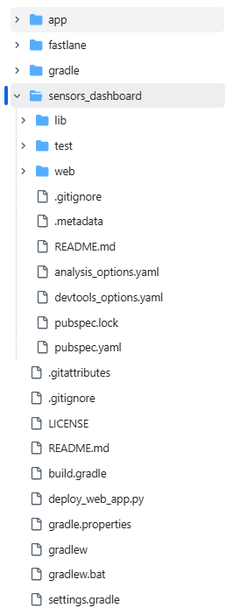
Ex4: >>
App Architecture
The app is built using the MVVM (Model-View-ViewModel) pattern.
Packages Used
http for http requests
web Lightweight browser API bindings built around JS interop.
get_it for dependency injection
fl_chart for real-time sensor plotting
provider for state management

Slide 19
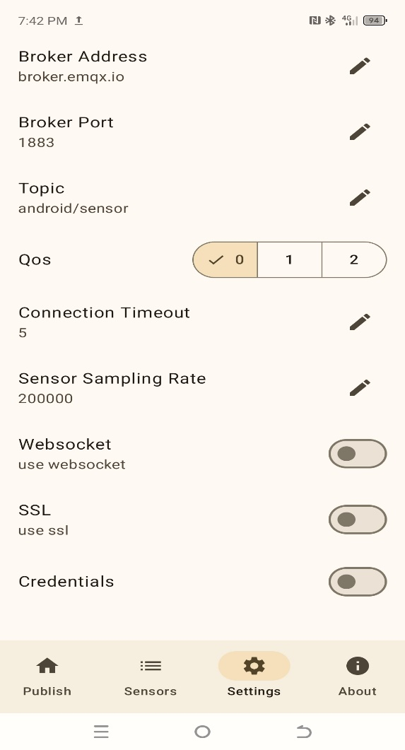
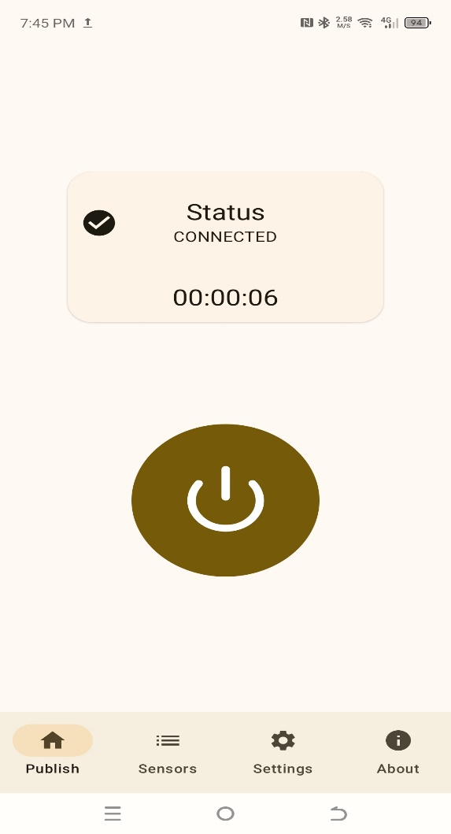
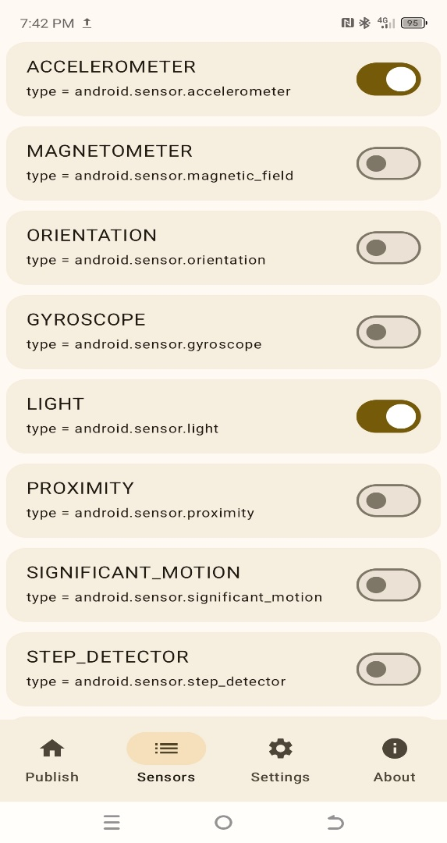
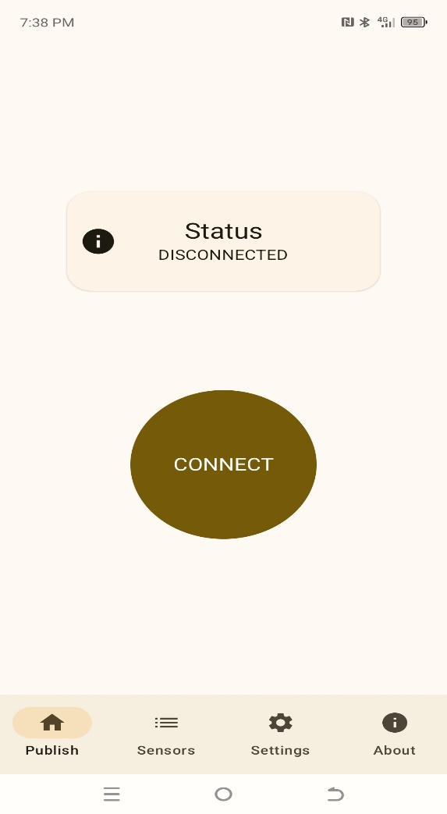
Ex4: >>
SensorSpot
https://github.com/amelcharolinesgn2/Gyroscope-Sensor-Data-Accelerometer/blob/main/SensorSpot-main.zip
Android app to stream real-time device sensor data to an MQTT broker. Select sensors, configure broker settings, and publish seamlessly
The App only supports MQTT v5 for now

Slide 20
Ex4: >>
SensorSpot
Gyroscope Sensor Accelerometer
https://github.com/amelcharolinesgn2/Gyroscope-Sensor-Data-Accelerometer/blob/main/SensorSpot-main.zip
This format is similar to one used in SensaGram}
Usage
Configure your broker settings.
Press Connect to start streaming the selected sensor data in real time.
App allows user to select or deselect sensors while connected, with the published data automatically updating to reflect the new choices.
The data is published to the topic android/sensor in the following JSON format:
{
"type": "android.sensor.accelerometer",
"timestamp": 3925657519043709,
"values": [0.31892395, -0.97802734, 10.049896]
}
Explanation
Array Item Description
values[0] Acceleration force along the x-axis (including gravity)
values[1] Acceleration force along the y-axis (including gravity)
values[2] Acceleration force along the z-axis (including gravity)
Notes:
https://github.com/amelcharolinesgn2/IoT_Project/blob/main/SensorServer.zip

Slide 21
Ex4: >>
GPS data format
GPS data is sent in following json format
{
"type": "android.gps",
"longitude": 155.9011,
"latitude": 81.4278,
"altitude": 217.5,
"bearing": 135.0,
"accuracy": 5.2,
"speed": 2.8,
"time": 1727845963000
}
timestamp: The time (in nanoseconds) when the event occurred. See the timestamp.
Note: For more details about other sensors data and what the values array represent, refer to the official Android documentation:
Motion sensors
Position sensors
Environmental sensors
https://developer.android.com/reference/android/hardware/SensorEvent#timestamp
https://developer.android.com/develop/sensors-and-location/sensors/sensors_motion?hl=id
Field | Description
longitude | Longitude in degrees.
latitude | Latitude in degrees.
altitude | The altitude of the location in meters above the WGS84 reference ellipsoid.
bearing | Bearing at the time of this location in degrees. Bearing is the horizontal direction of travel and is unrelated to device orientation. The bearing is guaranteed to be in the range [0, 360).
accuracy | Estimated horizontal accuracy radius in meters of this location at the 68th percentile confidence level.
speed | Speed at the time of this location in meters per second.
time | The Unix epoch time of this location fix, in milliseconds since the start of the Unix epoch (00:00:00 January 1, 1970 UTC).
https://developer.android.com/develop/sensors-and-location/sensors/sensors_position?hl=id
https://developer.android.com/develop/sensors-and-location/sensors/sensors_environment?hl=id
https://developer.android.com/develop/sensors-and-location/sensors/sensors_motion?hl=id
https://developer.android.com/develop/sensors-and-location/sensors/sensors_position?hl=id
https://developer.android.com/develop/sensors-and-location/sensors/sensors_environment?hl=id

Slide 22
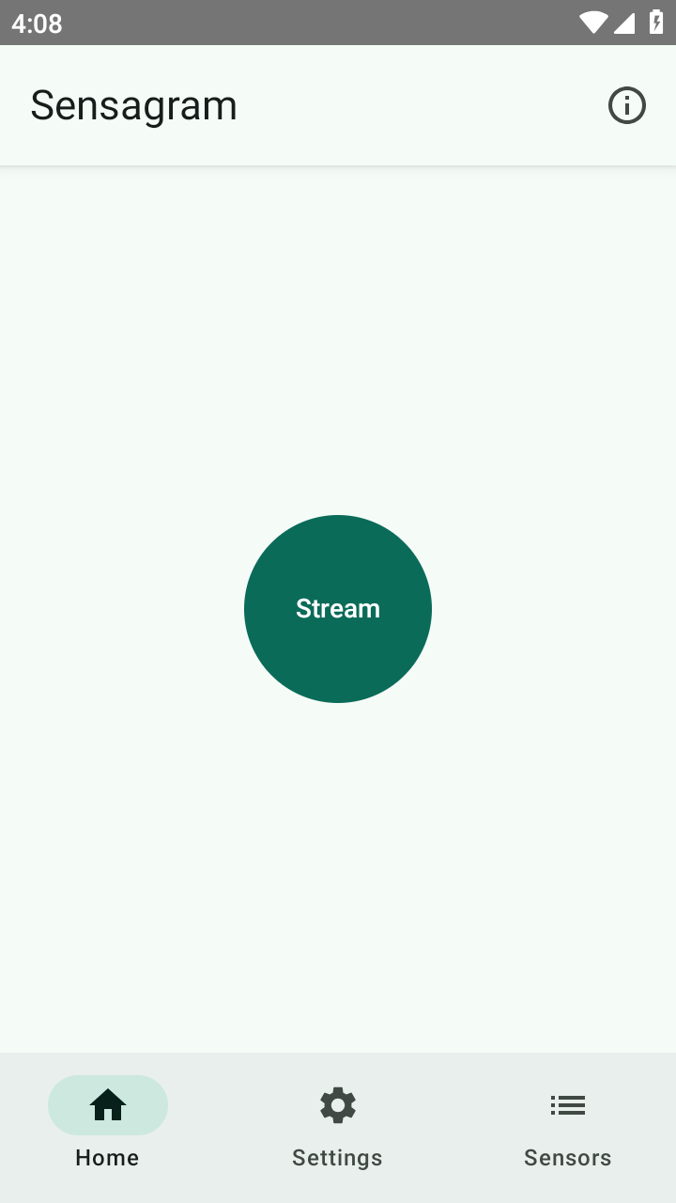
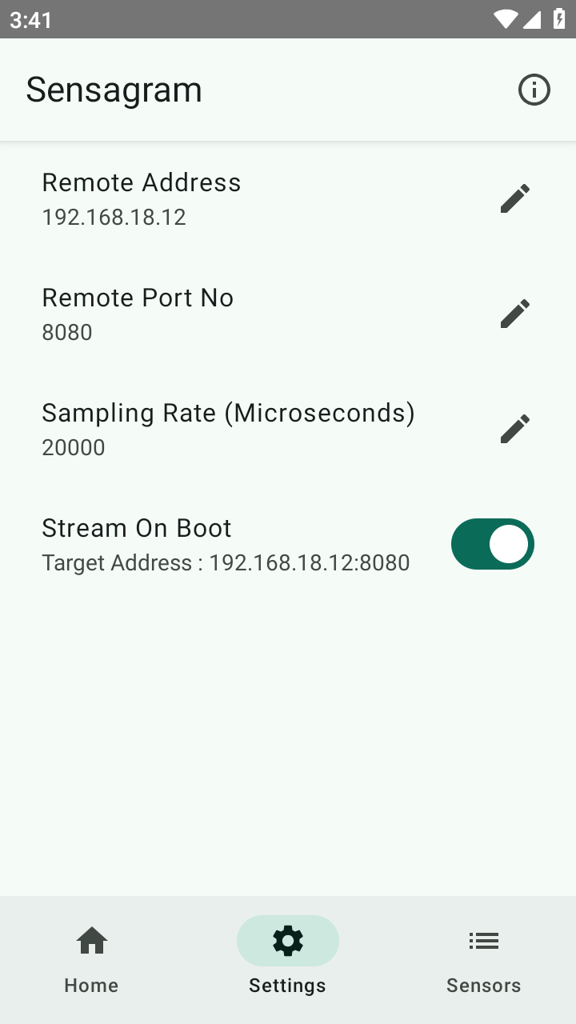
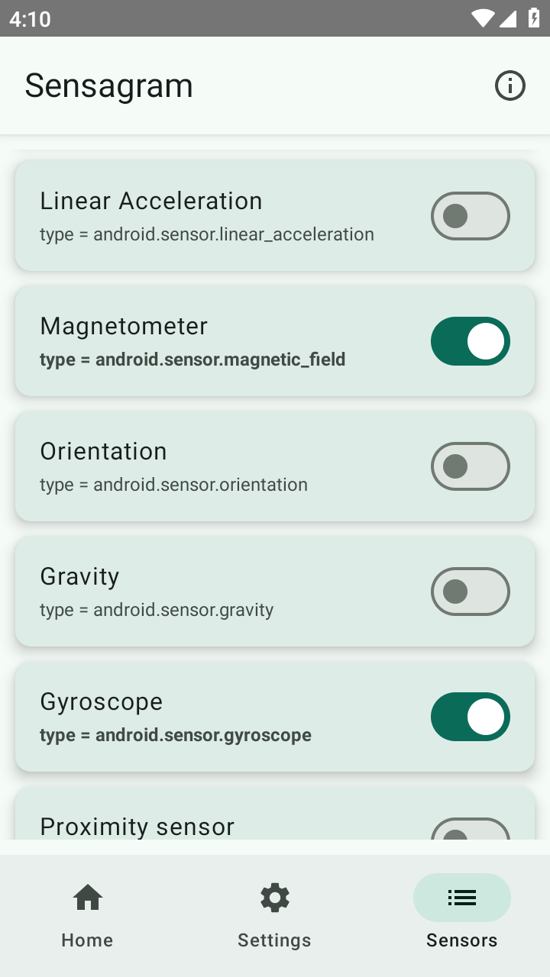
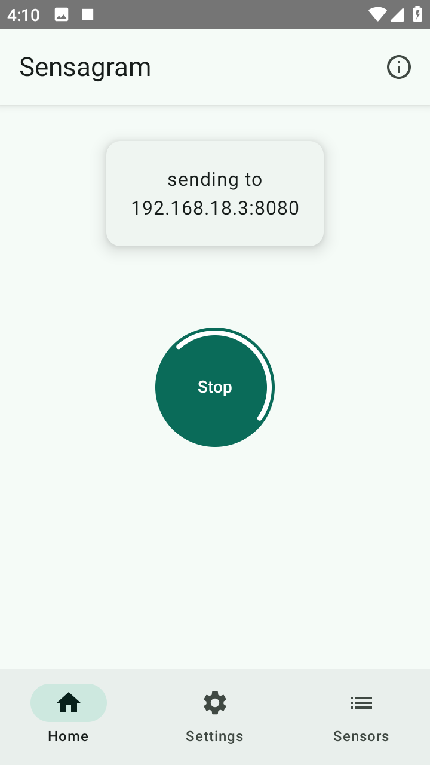
Ex4: >>
SensaGram
https://github.com/amelcharolinesgn2/Gyroscope-Sensor-Data-Accelerometer/blob/main/SensaGram-main.zip
tream real-time Android sensor data using UDP (User Datagram Protocol), a connectionless transport layer protocol designed for low-latency, fast data transmission without establishing a persistent connection.

Slide 23
Ex4: >>
Use JSON parser to get these individual values.
Note : Refer to the following official Android documentation links to understand what each value in the values array represents.
For motion sensors /topics/sensors/sensors_motion
For position sensors /topics/sensors/sensors_position
For Environmental sensors /topics/sensors/sensors_environment
Python example
The following Python code allows you to receive sensor data from the Sensagram app. The server will listen on all available network interfaces, which is indicated by the address 0.0.0.0. To set up the server, follow these steps:
Usage
In the app, select the desired sensors from the list and tap the "Stream" button. This will begin transmitting sensor data to the specified address. To receive the data, you'll need to set up a UDP server. The app sends the data in JSON format.
Note : You can dynamically control the data stream by selecting or deselecting sensors from the list during active streaming.This allows for flexible management of sensor data transmission.
{
"type": "android.sensor.accelerometer",
"timestamp": 3925657519043709,
"values": [0.31892395,-0.97802734,10.049896]
}
https://github.com/amelcharolinesgn2/Gyroscope-Sensor-Data-Accelerometer/blob/main/udpserver.py
where
And timestamp is the time in nanoseconds at which the event happened
Array Item | Description
values[0] | Acceleration force along the x axis (including gravity)
values[1] | Acceleration force along the y axis (including gravity)
values[2] | Acceleration force along the z axis (including gravity)

Slide 24
Ex4: >>
1. Clone the Gist repository:
see : udpserver.py
git clone https://github.com/amelcharolinesgn2/Gyroscope-Sensor-Data-Accelerometer/blob/main/udpserver.py
example
cd example
2. Create a Python file (e.g., server.py) in the example directory and add the following code:
from udpserver import UDPServer
import json
def onData(data):
jsonData = json.loads(data)
sensorType = jsonData["type"]
timestamp = jsonData.get("timestamp")
values = jsonData.get("values")
if sensorType == "android.sensor.accelerometer":
x, y, z = values
print(f"accelerometer : x = {x}, y = {y}, z = {z} timestamp = {timestamp} ")
if sensorType == "android.sensor.gyroscope":
x, y, z = values
print(f"gyroscope : x = {x}, y = {y}, z = {z} timestamp = {timestamp} ")
if sensorType == "android.gps":
longitude, latitude, altitude = jsonData["longitude"], jsonData["latitude"], jsonData["altitude"]
bearing, accuracy, speed, time = jsonData["bearing"], jsonData["accuracy"], jsonData["speed"], jsonData["time"]
print(f"longitude = {longitude} latitude = {latitude} altitude = {altitude}")
# Fields only for Android 8.0 and above.
speedAccuracyMetersPerSecond = jsonData.get("speedAccuracyMetersPerSecond")
bearingAccuracyDegrees = jsonData.get("bearingAccuracyDegrees")
elapsedRealtimeNanos = jsonData.get("elapsedRealtimeNanos")
verticalAccuracyMeters = jsonData.get("verticalAccuracyMeters")
# Initialize the server to listen on all network interfaces (0.0.0.0) and port 8080
server = UDPServer(address=("0.0.0.0", 8080))
server.setDataCallBack(onData)
server.start()
for GPS data description see GPS Data Description
3 Run the script on the machine you want to receive data on:
python server.py

Slide 25
Ex4: >>
for GPS data description see GPS Data Description
GPS Data Description
Field | Description
speedAccuracyMetersPerSecond | Estimated speed accuracy in meters per second of this location at the 68th percentile confidence level.
bearingAccuracyDegrees | Estimated bearing accuracy in degrees of this location at the 68th percentile confidence level.
elapsedRealtimeNanos | Time of this fix in nanoseconds of elapsed realtime since system boot.
verticalAccuracyMeters | The estimated altitude accuracy in meters of this location at the 68th percentile confidence level.
Field | Description
longitude | Longitude in degrees.
latitude | Latitude in degrees.
altitude | The altitude of the location in meters above the WGS84 reference ellipsoid.
bearing | Bearing at the time of this location in degrees. Bearing is the horizontal direction of travel and is unrelated to device orientation. The bearing is guaranteed to be in the range [0, 360).
accuracy | Estimated horizontal accuracy radius in meters of this location at the 68th percentile confidence level.
speed | Speed at the time of this location in meters per second.
time | The Unix epoch time of this location fix, in milliseconds since the start of the Unix epoch (00:00:00 January 1, 1970 UTC).

Slide 26
3 Run the script on the machine you want to receive data on:
python server.py
⚠️ Make sure your firewall settings are not blocking incoming data. see issue Firewall caused errors
4. Configure the Sensagram app:
In the app's settings, enter the IP address of the machine running this script. To find your machines's IP address:
On Windows, use the ipconfig command.
On Linux, use the ifconfig command.
Stream On Boot
The app can stream sensor data to a specified address upon device boot. For devices running Android 9 or lower, the app automatically enables Wi-Fi on boot and starts the data stream. However, for devices running Android 10 and later, apps cannot directly control Wi-Fi settings. Therefore, you need to ensure your device's Wi-Fi is enabled before shutting down or restarting. This allows the system to automatically restore the Wi-Fi state when the device boots up. Additionally, make sure the app is not restricted from performing backgr

Slide 27
Gyroscope Sensor Accelerometer
https://github.com/amelcharolinesgn2/Gyroscope-Sensor-Data-Accelerometer/blob/main/Getting%20Data%20From%20GPS
https://github.com/amelcharolinesgn2/IoT_Project/blob/main/sensors_data_streaming.zip
https://github.com/amelcharolinesgn2/IoT_Project/blob/main/SensorServer.zip
https://github.com/amelcharolinesgn2/Gyroscope-Sensor-Data-Accelerometer/blob/main/awesome-websockets-master.zip
https://github.com/amelcharolinesgn2/Gyroscope-Sensor-Data-Accelerometer/blob/main/Connecting%20to%20Multiple%20Sensors%20Using%20Threading%20in%20Python

Slide 28
Thank you!
PDS
Computer Vision
Thank you For being a great class!
https://github.com/siagianp
https://www.youtube.com/@AmelOline/videos
https://github.com/amelcharolinesgn2/IoT_simulator-mqtt-NodeRed
https://github.com/amelcharolinesgn2/Cloud-Infrastructures
https://github.com/amelcharolinesgn2/ClouD-Infrastructure-SISKA-2025

